Slide 1
Brain Tumor Segmentation Using CNN and U-Net
Guided By: Mr.S.Suneel Kumar Asst.Professor
Presented By: K.Bharathi(20C51A6621)
V.Sujan Reddy(20C51A6651) G.Surya Naik(20C51A6614) M.Trinath Reddy(20C51A6624)

Slide 2
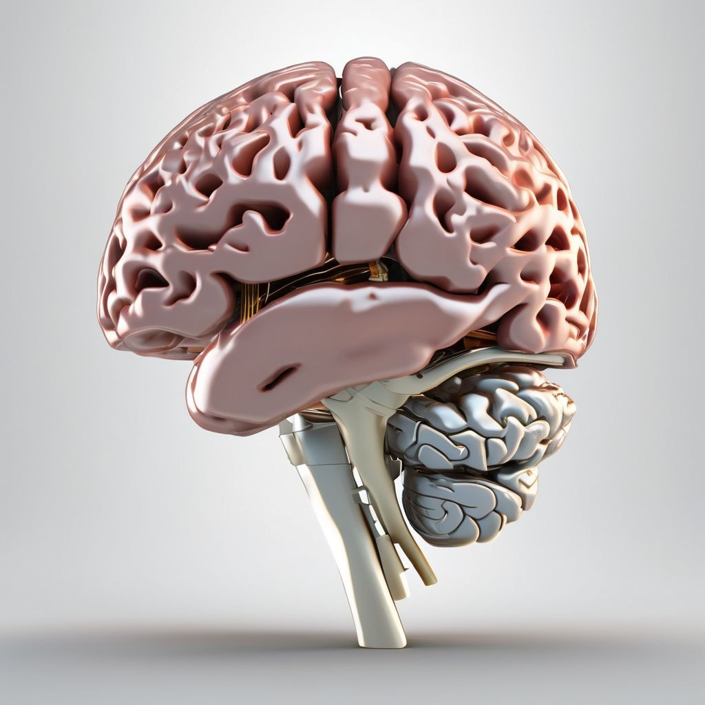
ABSTRACT
Brain tumor segmentation from medical images is critical for timely diagnosis and treatment planning. This study proposes a deep learning approach utilizing Convolutional Neural Network(CNN) and U-Net architecture for improved accuracy and efficiency in brain tumor detection. Our method involves preprocessing of MRL images followed by feature extraction and classification using CNNS.

Slide 3
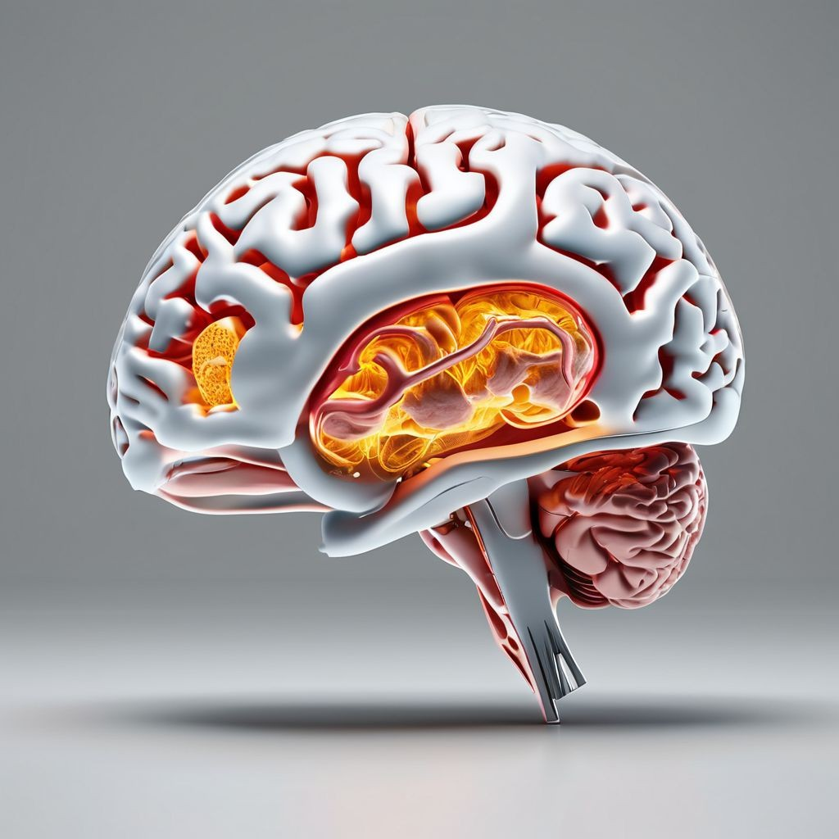
ABSTRACT
Additionally, U-net is employed for precise segmentation of tumor regions. The integration of CNN and U-Net allows for comprehensive analysis and selection of brain tumors. Experimental results demonstrate the effectiveness of our approach, achieving the high accuracy and robust performance compared to traditional methods. This research contributes to advancing the field of medical images analysis and hold promise for enhancing clinical diagnosis and patient care in neuroimaging.

Slide 4
Introduction
Brain tumors represent a significant health concern globally, with millions of individuals diagnosed each year. Early detection and accurate diagnosis are paramount for effective treatment planning and improving patient outcomes. Medical imaging, Particularly Magnetic Resonance Imaging(MRI), Plays a crucial role in the detection and characterization of brain tumors. However, manual interpretation of MRI scans by radiologists is time-consuming, subjective, and prone to errors

Slide 5
Introduction
Recent advancement in deep learning, particularly CNNs, have transformed medical image analysis, enabling automated detection and segmentation of abnormalities,
U-Net, a specialized architecture for biomedical image segmentation, excels in capturing intricate structures accurately. The integration of CNN and U-Net offers a promising approach for enhancing brain tumor detection and segmentation. CNNs extract features effectively, while U-Net precisely localizes and segments tumor regions.

Slide 6
Software Requirements
Deep Learning Frameworks: Such as TensorFlow, Keras for implementing and training the models.
Data manipulation libraries: such as NumPy

Slide 7
Hardware Requirements
Processor: intel core i5 or above.
64-bit, quad-core, 2.5 GHz minimum per core
Ram: 4GB or more
Hard Disk: 10 GB of available space
Operating System: Windows

Slide 8
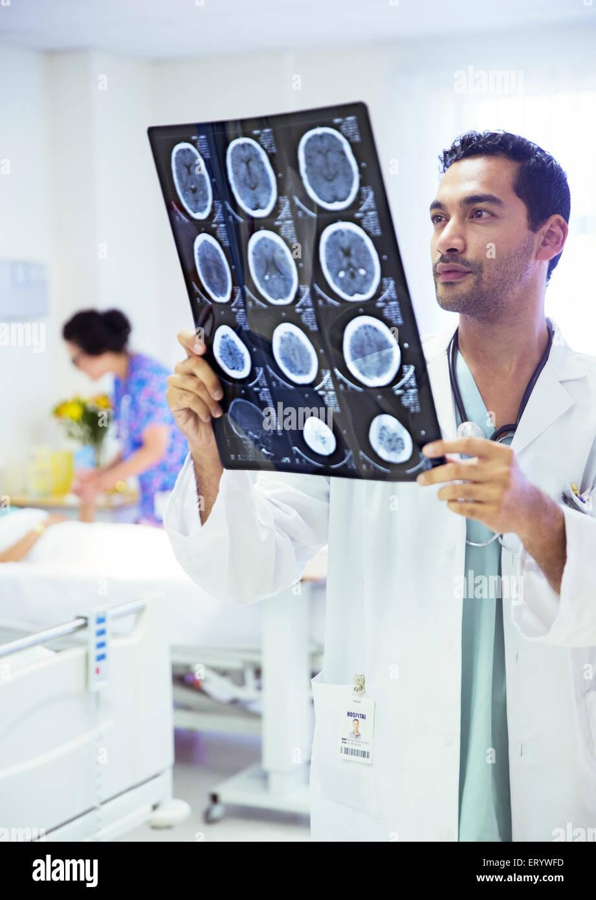
Existing System
In the existing system, brain tumor detection often relies on manual interpretation of MRL images by radiologists. Traditional image processing techniques may be used for tumor detection which are often time-consuming and require extensive manual effort. These methods may lack the ability to accurately capture intricate tumor structures and variations in size and shape. The existing system may not provide real-time or automated detection capabilities, leading to delays in diagnosis and treatment planning.

Slide 9
Proposed System
To implement this project we are using 4 different images and this images are called as FLAIR, T1, T2 and T1CE and the label segmented image. The multi-institutional dataset, acquired from 19 different contributors, contains multimodal MRI scans of each patient, namely T1, T1 contrast-enhanced (T1ce), T2-weighted (T2), and Fluid Attenuated Inversion Recovery (FLAIR), from which the tumoural sub regions are segmented. The data is processed to overcome discrepancies such that they are skull-stripped.

Slide 10
Modules
1.Upload BRATS Dataset
2.Generate CNN & UNET Model
3.Upload Test Image & Segmentation
4.Dice Similarity Graph

Slide 11
1.Uploading the Brat Dataset
Upload BRATS Dataset is the first module of our project,it is used to upload the BRATS dataset
2.Generate CNN & UNET Model:
Generate CNN & UNET Model is the second module of our project,it is used to models are generated and console to see CNN and UNET layer details. we can see models are using different size images to filter them and to get best features from it to build efficient model and now model is generated.

Slide 12
Upload Test Image & Segmentation:
Upload Test Image & Segmentation is the third module of our project and then upload test samples to get segmented output. selecting and uploading ‘Sample1’ folder and then click on ‘Select Folder’ button to get below output top 4 images are the input images such as FLAIR, T1, T2 and T1CE and 5th image is the predicted image with segmented part showing in red colour and this algorithm correctly detecting and marking tumour area and now test with other image.

Slide 13
4.Dice Similarity Graph:
To build CNN and UNET model we took 50 epoch or iterations and at each iteration DICE score between training and testing images get better and better and we get final dice score as 0.8 * 100 = 80%.

Slide 14
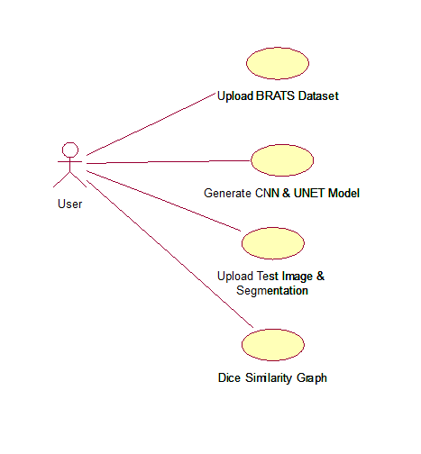
Use Case Diagram

Slide 15
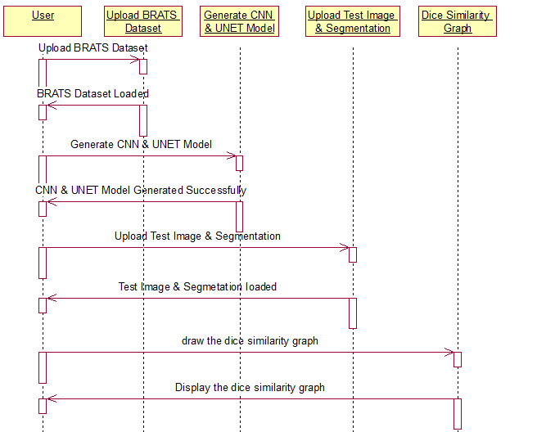
Sequence Diagram

Slide 16
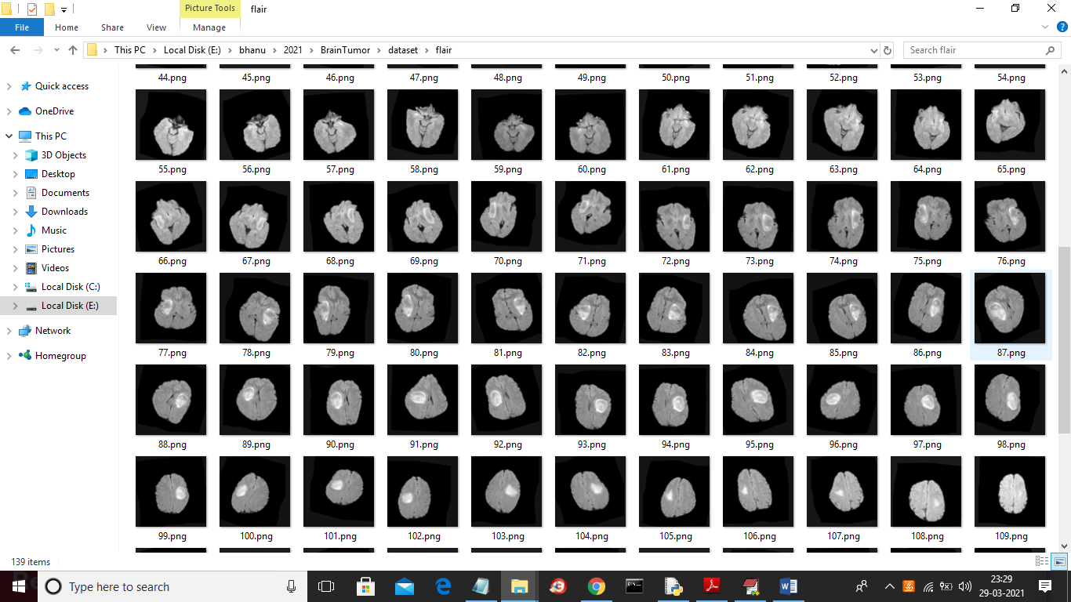
Output:
Above dataset is used to train CNN and UNET model

Slide 17
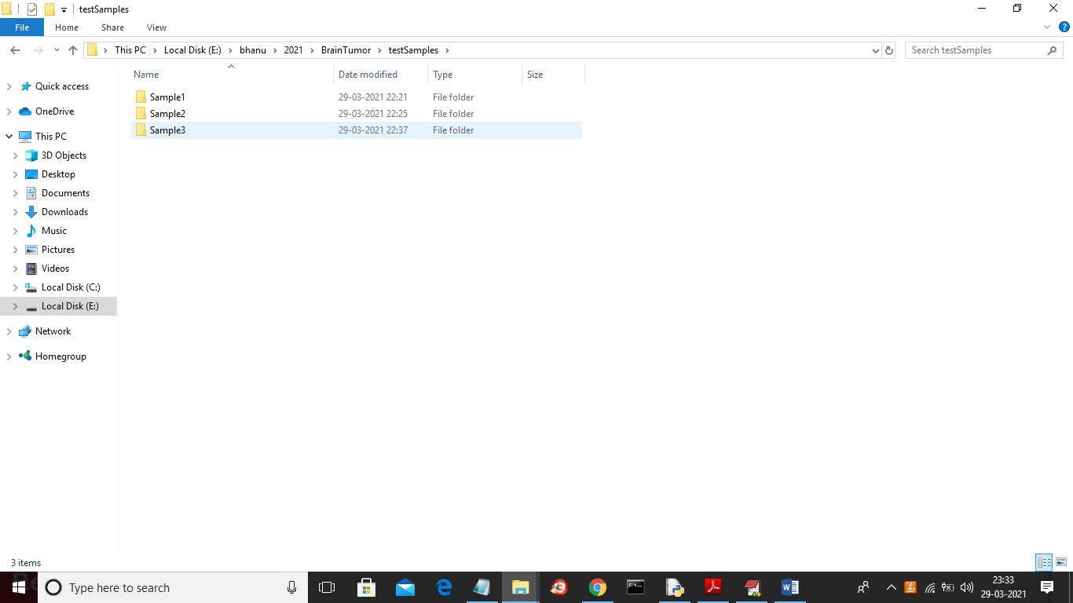
After building UNET and CNN model we will upload test images from ‘testSamples’ folder and then UNET model will give us segmented image. Below screen shots showing testSamples image

Slide 18
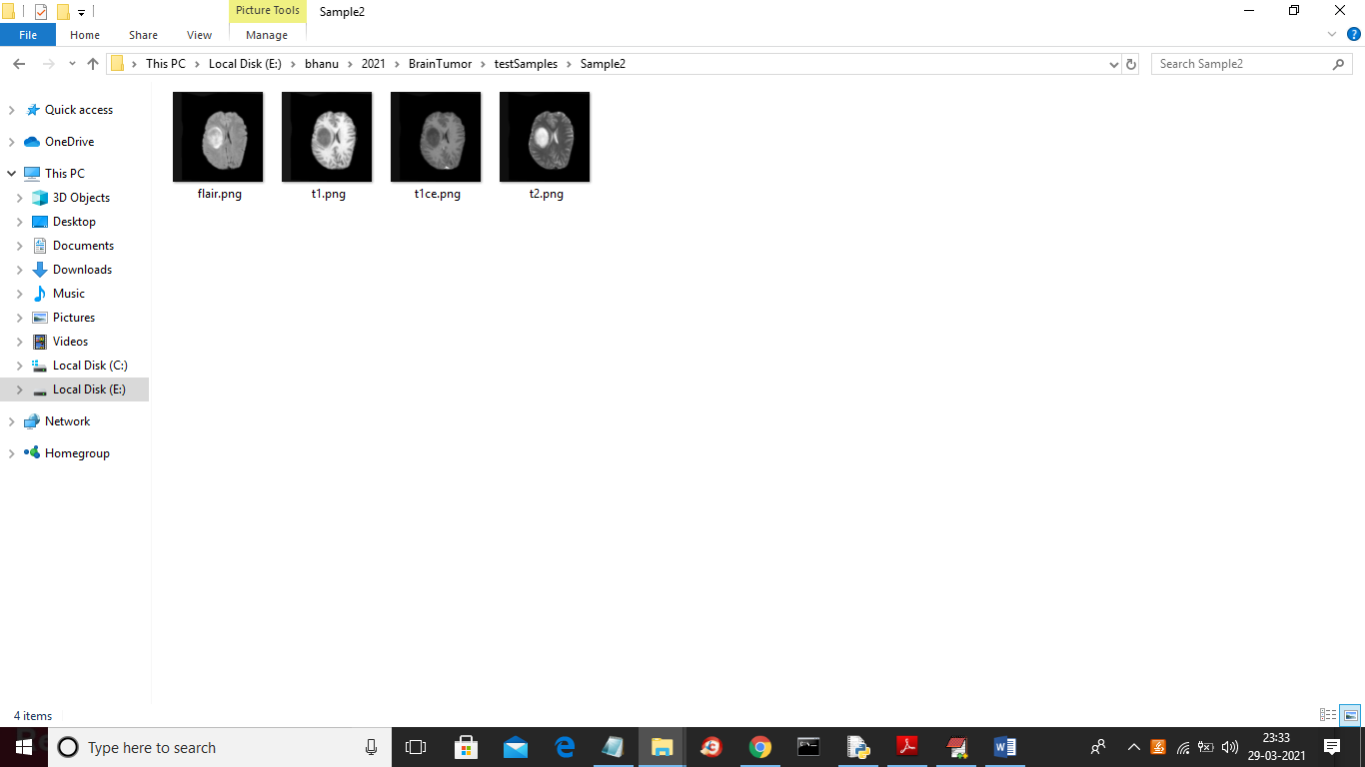
In above screen we have FLAIR, T1, TICE and T2 images but we don’t have segmented label image and after applying model on above images then we will get segmented label image

Slide 19
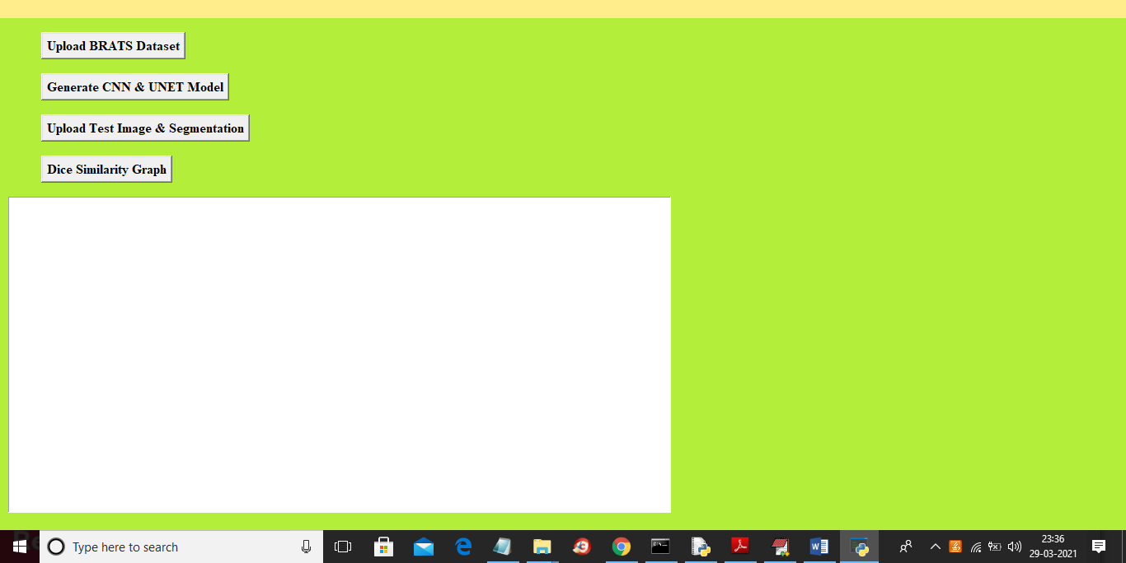

Slide 20
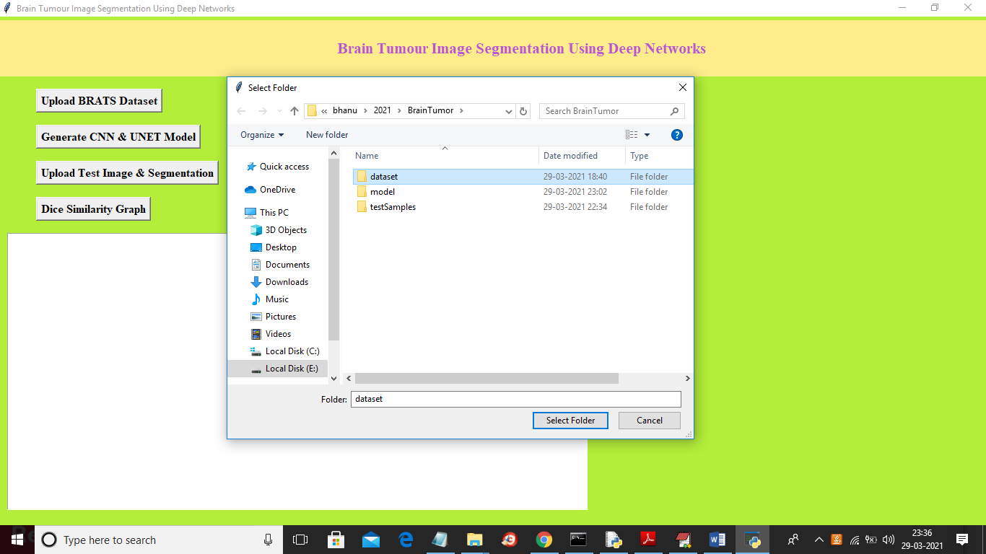

Slide 21


Slide 22


Slide 23
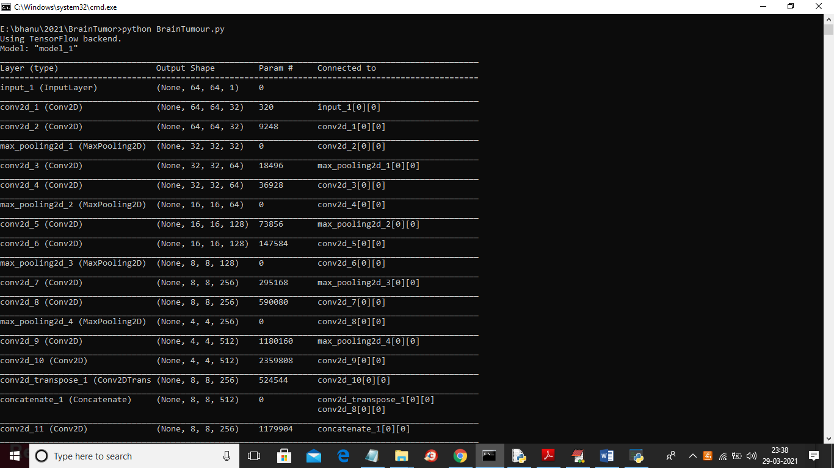

Slide 24
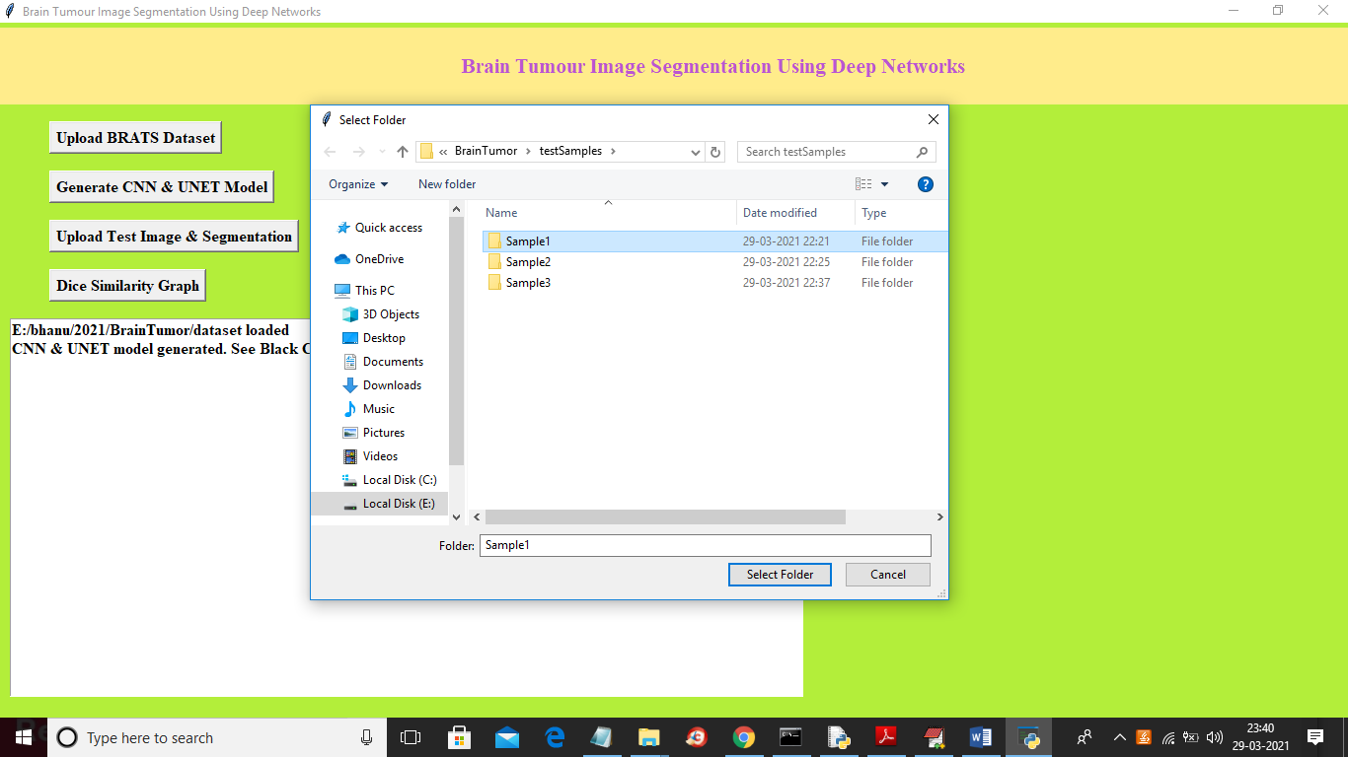

Slide 25
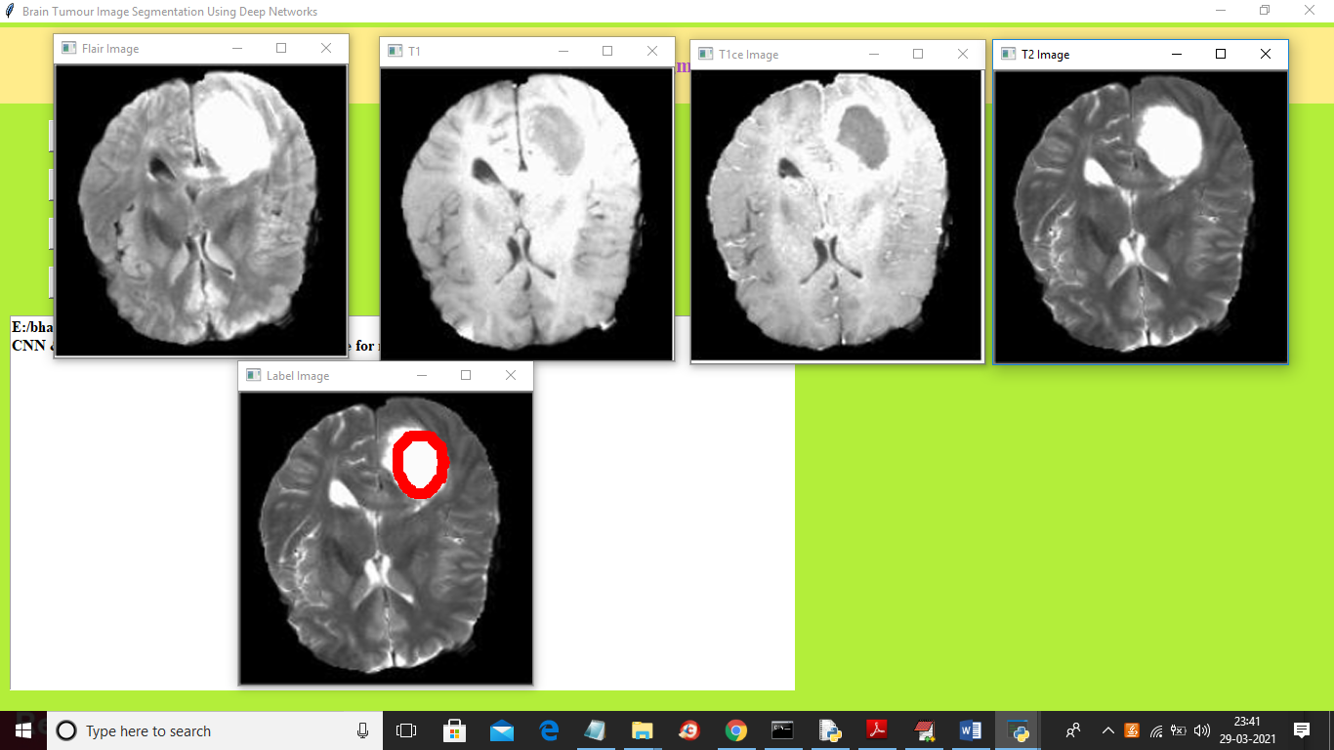

Slide 26
Conclusion
Detecting brain tumors using convolutional neural networks (CNNs) and U-Net architecture represents a significant advancement in medical imaging and diagnosis. Through extensive research and experimentation, it has been demonstrated that deep learning models can effectively analyze MRI scans and accurately identify the presence and characteristics of brain tumors. The utilization of CNNs allows for the extraction of intricate features from complex imaging data, while u-net architecture excel in semantic segmentation tasks, enabling precise delineation of tumor boundaries

Slide 27
Thank You

